Slide 1
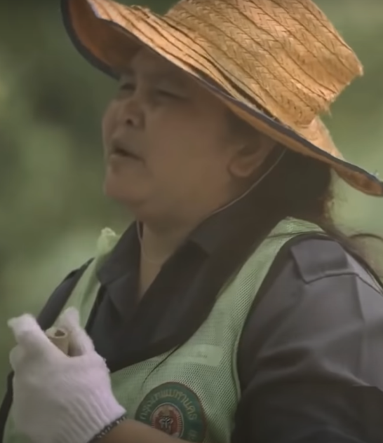
Garbage Man
A young student's heartwarming tribute to his hardworking mother, a street cleaner, through his imaginative superhero creation “
Garbage Man" - a hero dedicated to keeping the streets spotless.
by ROHIT Saraswat

Slide 2




Characters in Garbage Man
Pornchai
Pornchai's Mother
The Teacher
Pornchai's Friends
A young boy who admires his mother's hard work and sees her as his superhero.
Encourages students to empathize with all forms of labor through a thoughtful superhero assignment.
A dedicated street cleaner who inspires her son through her perseverance and compassion.
Represent typical schoolchildren who provide a backdrop for Pornchai's unique perspective.

Slide 3
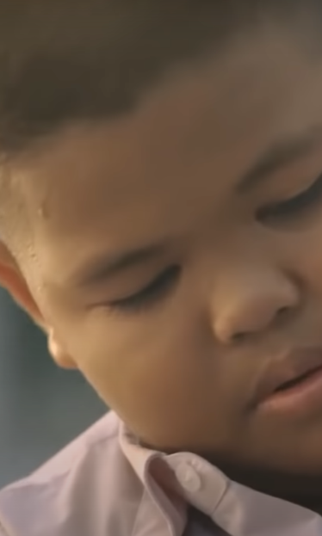
Lesson from Garbage Man
Recognize Unsung Heroes
Inspire with Kindness
The film encourages us to appreciate the essential yet often overlooked workers who contribute to our daily lives, like garbage collectors.
A simple act of kindness and admiration from a child can inspire heroism and make a lasting impact on someone's life.
Find Meaning in Ordinary Tasks
Even ordinary, everyday jobs can be sources of pride and purpose when viewed through the lens of service to the community.

Slide 4
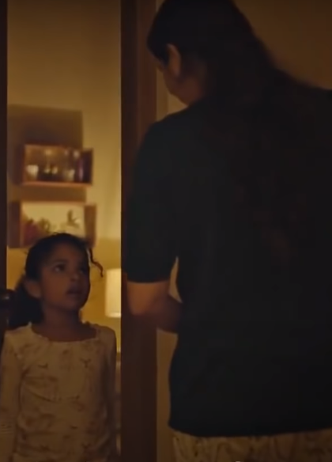
The Unsung Heroine
This short film shines a light on the unrecognized labor of mothers and wives who juggle work, household chores, and childcare during difficult times. Their tireless efforts often go unnoticed, but this story reminds us to appreciate the strength and resilience of these unsung heroines.

Slide 5
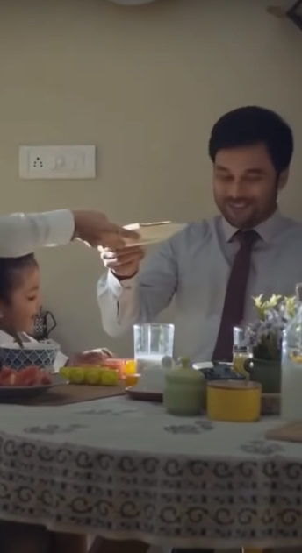
Characters in The Unsung Heroine
The Little Girl
The Mother
Observant and empathetic, the little girl notices her mother's tireless efforts to keep the household running during the lockdown. She is concerned for her mother's wellbeing.
A resilient and hardworking woman, the mother juggles multiple roles - caring for her family, maintaining the home, and even supporting her community during challenging times.
The Father
Initially unaware of the true scope of his wife's responsibilities, the father gradually develops a deeper appreciation for her unwavering dedication and the sacrifices she makes to keep the family afloat.

Slide 6



The Unsung Heroine
Household Management
Tireless Efforts
Shared Responsibilities
It emphasizes the immense physical and emotional toll this work can take, especially during challenging times when families need extra support.
The story serves as a reminder to appreciate these efforts and ensure the primary caregivers receive the support and rest they need.
The film sheds light on the often unseen labor that women perform to maintain a household, from cleaning and cooking to caring for family members.

Slide 7
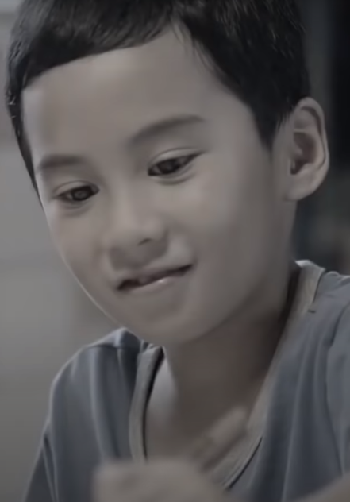
Reunion Dinner
The final video in the series tells the story of the cherished Chinese New Year tradition of the reunion dinner. It portrays this gathering as a time to set aside the year's challenges and come together as a family, united by an enduring bond.

Slide 8
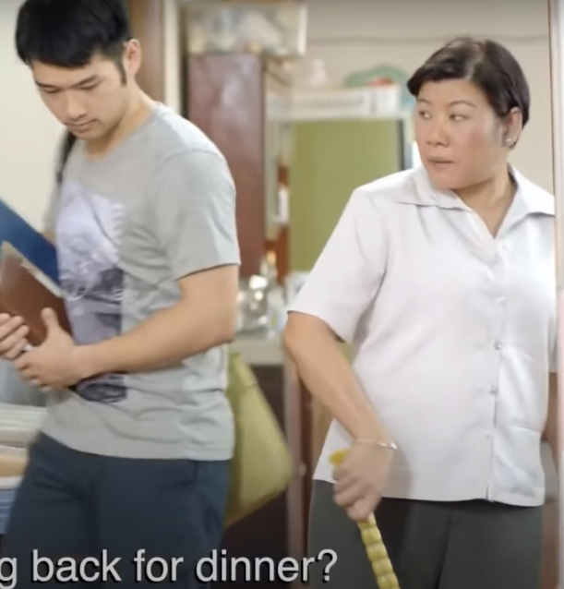
Reunion Dinner: Characters
In "Reunion Dinner," the mother is portrayed as a resilient and dedicated figure, embodying selflessness as she tirelessly works to ensure her family's well-being. Her actions and sacrifices highlight the deep love and commitment parents have for their children. The children represent the younger generation, initially unaware of their parents' sacrifices. Through the story, they learn to appreciate and honor their parents' efforts, gaining a deeper understanding of family values and gratitude. This evolving perspective underscores the film's theme of familial appreciation and unity.

Slide 9
Reunion Dinner: Honoring Family Bonds
Appreciating Sacrifices
Cherishing Family
The video teaches the younger generation to recognize and appreciate the sacrifices their parents make to provide for the family. It reminds viewers of the significance of gathering together during important cultural celebrations like Chinese New Year.
The story underscores the values of gratitude, respect, and familial love, encouraging viewers to cherish and honor the deep bonds that connect them to their loved ones. It inspires a renewed sense of appreciation for one's family.
Notes:
• The video we just watched highlights the importance of recognizing the sacrifices our parents make to provide for the family. • It reminds us of the significance of gathering together during important cultural celebrations like Chinese New Year - these are precious moments to cherish our family bonds. • The story underscores the values of gratitude, respect, and familial love. It encourages us to deeply appreciate and honor the connections we have with our loved ones. • The key lesson is to cultivate a renewed sense of appreciation for our family - to cherish these relationships and the support they provide.

Slide 10
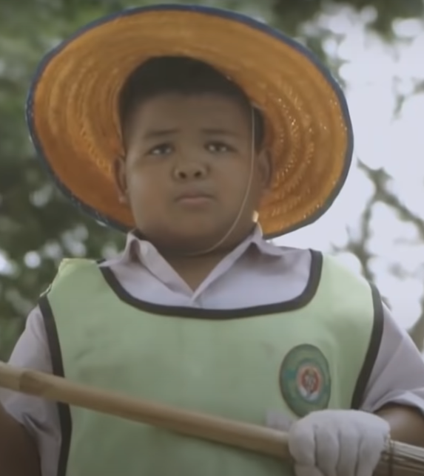
Conclusion
Admiration for Everyday Heroes
The Power of Empathy and Gratitude
These stories inspire us to recognize and appreciate the invaluable contributions of the unsung heroes around us, whether they are family members, community workers, or essential personnel.
By highlighting the importance of empathy, respect, and gratitude, the films encourage viewers to cultivate a deeper understanding and appreciation for the people who make a difference in our lives.
Celebrating the Extraordinary in the Ordinary
These heartwarming tales remind us that the most extraordinary acts often come from the most ordinary people, whose tireless efforts and selfless dedication make our communities and families stronger.

